Slide 1
Copy the content on slide #2 into your own presentation template and style
Add this logo to your presentation:
Notes:
GROWTHplus Investment Account communication to employees
Purpose: Let your employees know about CAAT’s GROWTHplus Investment Account and remind them where they can find more information.
Format: PowerPoint Presentation
Copy and paste the subject line and body text into your own presentation template and slide. Please include the logo provided.

Slide 2
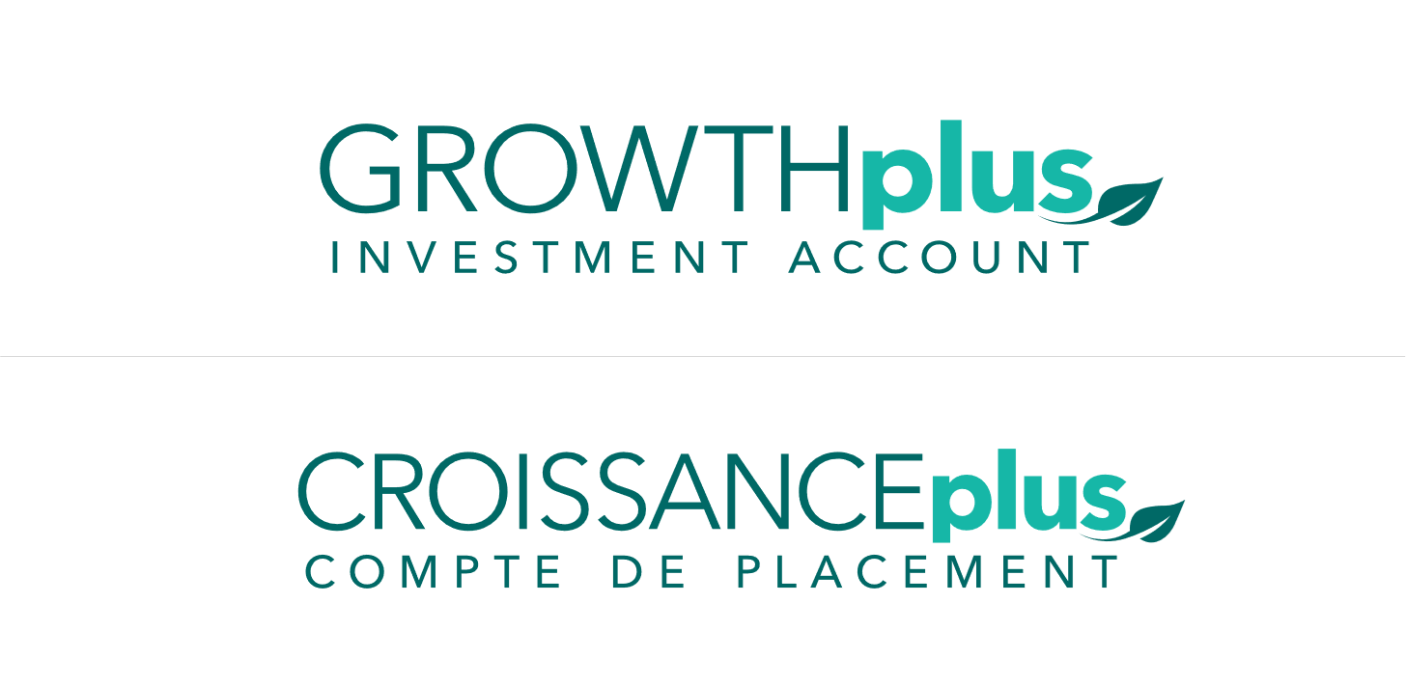
GROWTHplus Investment Account
Optional savings account for eligible employees to grow your tax-sheltered savings
Benefit from CAAT’s investment returns
Grow your savings together with the secure lifetime pension you have with CAAT
No additional employer contributions
Transfer-in tax sheltered savings using My Pension
Notes:
1. GROWTHplus Investment Account is an optional savings account for CAAT Pension Plan members to grow their tax-sheltered savings with an organization they trust.
2. Eligible members of the pension plan can benefit from CAAT’s investment returns and leave the investment decisions to CAAT’s professionals.
Returns are based on CAAT’s investment performance
The Plan’s 10-year average net investment return was 9.3% as of December 31, 2023.
At CAAT, our investments team evaluates and invests in different opportunities.
If you transfer-in funds into GROWTHplus, your savings will benefit from CAAT’s scale and asset mix. This mix includes private equity, infrastructure and real estate.
3. With GROWTHplus, you can grow your savings alongside the secure lifetime pension you have with CAAT. GROWTHplus complements CAAT’s existing DB pension plan designs – it does not replace them. It gives you an additional tool to achieve your financial goals in retirement.
4. As an optional savings account for members, your employer does not contribute to your GROWTHplus account like they do with your CAAT defined benefit pension.
5. You can transfer-in funds until the end of the year you turn 70. Active, deferred and retired members of the Plan can all participate in GROWTHplus. This means you can continue to participate in GROWTHplus and benefit from the Plan’s investment returns throughout the different stages of your life. If you want to get started, you’ll need to make sure your My Pension account is set up.
6. If you have questions, visit the GROWTHplus webpage https://www.caatpension.ca/members/GROWTHplus
Or contact CAAT directly at member@caatpension.ca

